Slide 1
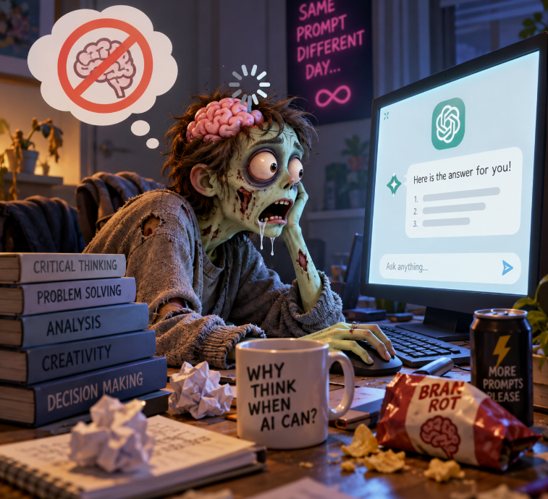
The Problem:
Pauline Prinz (WU)
Fatemeh Sepehri(University of Vienna)
Sara Klasová (WU)
Arshia Fajar (FH St. Pölten)

Slide 2
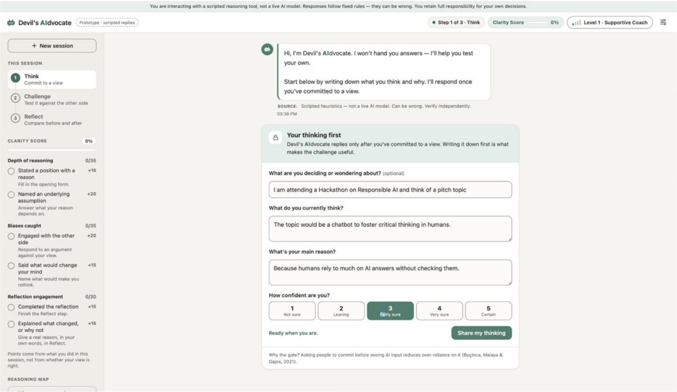
The Solution: “Devil’s AIdvocate”:
For those who seek real growth, not shortcuts.
It doesn’t just give you the answer - it teaches you how to find it yourself!
An AI thinking coach / sparring partner that
1
strengthens your critical thinking
2
challenges your assumptions
3
helps you become an independent thinker

Slide 3








The Responsibility Aspects:
Four aspects built into the code — each one verified by automated tests
Privacy and Data protection
Human autonomy and psychological safety
Harmful content and topic boundaries
Human oversight and accountability
Personal identifiers removed before the AI sees them
Nothing stored on the server; logs hold no user text
Think First: the AI replies only after you commit
Never decides; nudges solo thinking after 5 sessions a day
Distress stops the debate and shows support lines
Questions only; user text is data, never commands
Every reply shows model, basis, confidence and sources
You decide and stay responsible; fallbacks are announced
Tested: no identifier reaches the AI
Tested: “you should…” is blocked
Tested: hidden distress is caught
Tested: no source, no reply
Fairness and non-discrimination
Transparency and explainability
Hallucination and Source Reliability

Slide 4
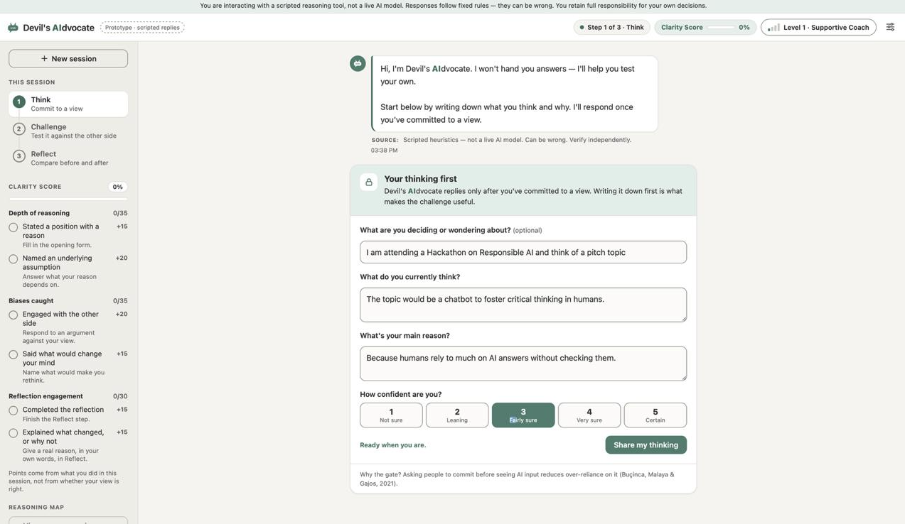
Demo: Scenario hackathon

Slide 5
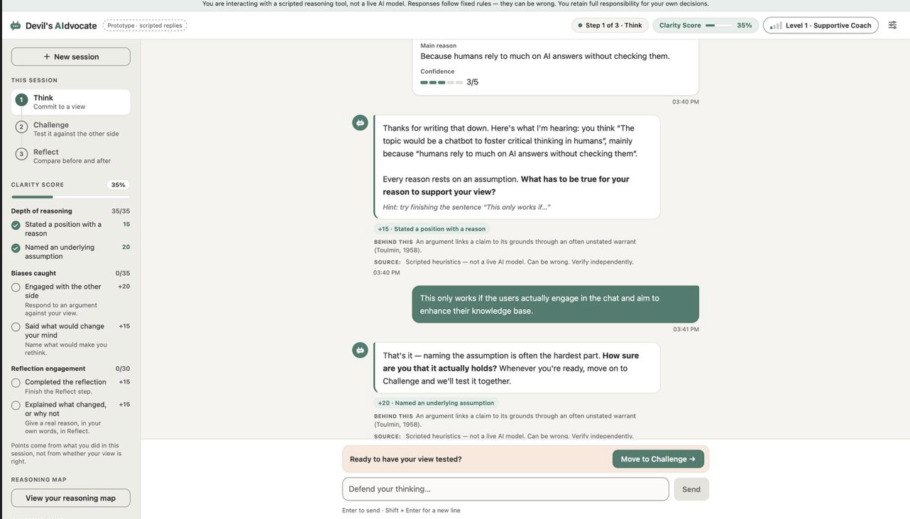
Demo: Scenario hackathon

Slide 6
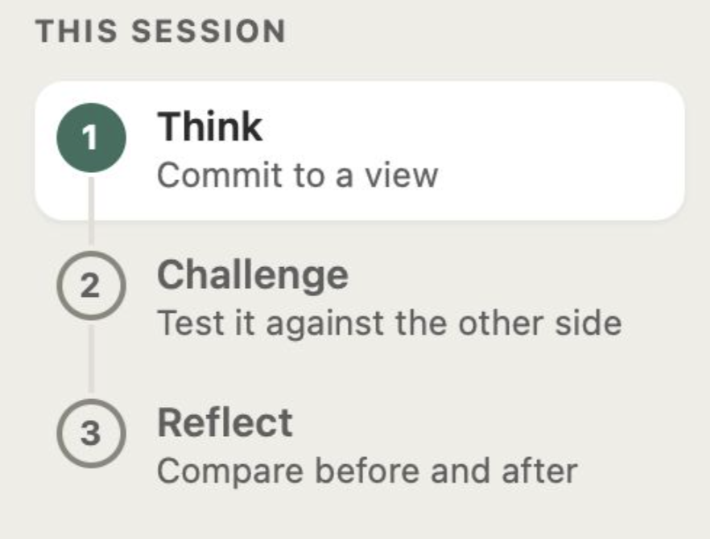
Demo: Scenario hackathon

Slide 7
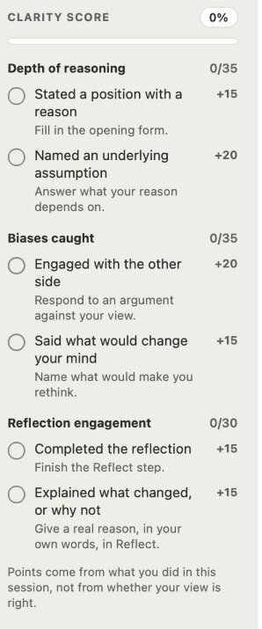
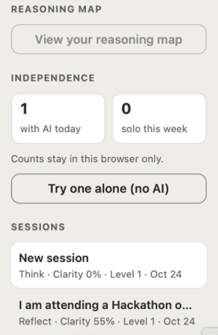
Demo: Scenario hackathon

Slide 8
Background Literature:
1
Bisra, K., Liu, Q., Nesbit, J. C., Salimi, F., & Winne, P. H. (2018). Inducing self-explanation: A meta-analysis. Educational Psychology Review, 30, 703–725. https://doi.org/10.1007/s10648-018-9434-x
4
Lee, H.-P., Sarkar, A., Tankelevitch, L., Drosos, I., Rintel, S., Banks, R., & Wilson, N. (2025). The impact of generative AI on critical thinking: Self-reported reductions in cognitive effort and confidence effects from a survey of knowledge workers. In Proceedings of the 2025 CHI Conference on Human Factors in Computing Systems (Article 1121, pp. 1–22). Association for Computing Machinery. https://doi.org/10.1145/3706598.3713778
2
Carpenter, S. K., Pan, S. C., & Butler, A. C. (2022). The science of effective learning with spacing and retrieval practice. Nature Reviews Psychology, 1, 496–511. https://doi.org/10.1038/s44159-022-00089-1
5
National Institute of Standards and Technology. (2023). Artificial intelligence risk management framework (AI RMF 1.0) (NIST AI 100-1). U.S. Department of Commerce. https://doi.org/10.6028/NIST.AI.100-1
3
Flavell, J. H. (1979). Metacognition and cognitive monitoring: A new area of cognitive-developmental inquiry. American Psychologist, 34(10), 906–911. https://doi.org/10.1037/0003-066X.34.10.906
6
Parasuraman, R., & Manzey, D. H. (2010). Complacency and bias in human use of automation: An attentional integration. Human Factors, 52(3), 381–410. https://doi.org/10.1177/0018720810376055

